Slide 1

Learning Objectives:
I can evaluate teamwork and problem-solving skills through peer assessment.
I can reflect on the importance of cybersecurity and the skills I learned during the Escape Room.
I can provide constructive feedback to my peers based on their performance in the Escape Room.
Success Criteria:
All: Provide feedback on teamwork and problem-solving skills during the Escape Room.
Most: Write a reflective piece on the importance of cybersecurity and how learned skills apply to real life.
Some: Offer detailed peer feedback and in-depth reflection on personal insights gained from the activity.

Slide 2
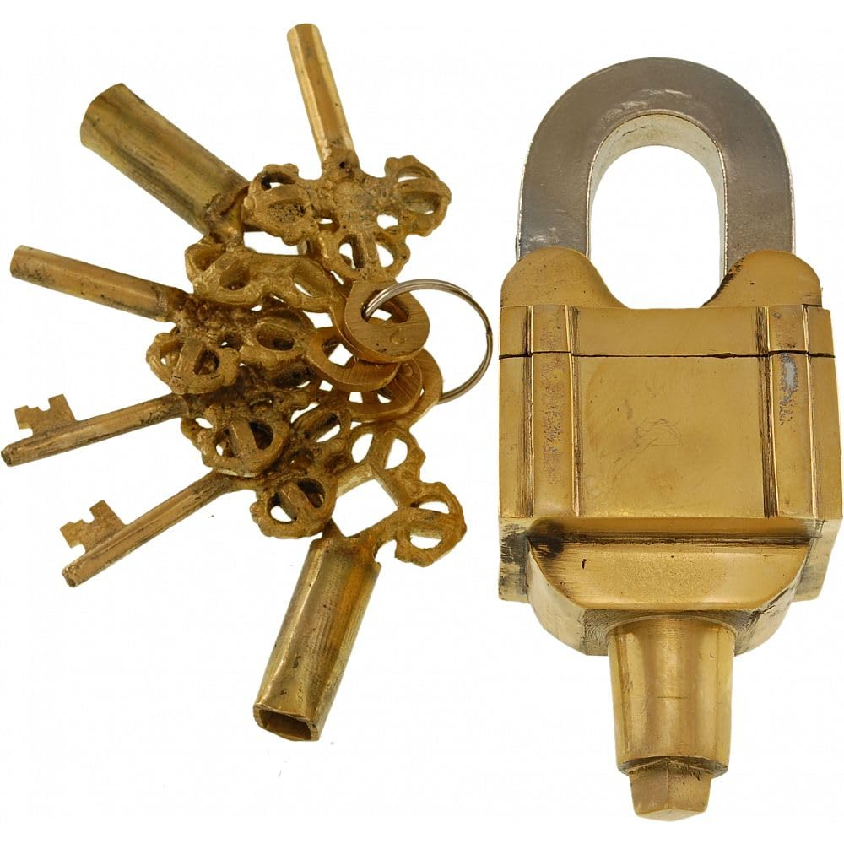
Recap of the Escape Room
Let’s start with a quick recap of the Escape Room Challenge. What part of the challenge did you enjoy the most? Did your team develop any strategies that helped you complete the stations? Reflect on your personal contributions and share them with your group.
What was your favourite part of the Escape Room Challenge?
What strategies did your team use to overcome obstacles?
How did you contribute to your team’s success?

Slide 3
Peer Assessment
For the next part of the lesson, you’ll evaluate another team’s performance during the Escape Room Challenge. Use the peer assessment forms and focus on teamwork, communication, and how well they solved problems. This is a chance to give constructive feedback—think about what worked and what could be improved.
Evaluate another team’s performance in the Escape Room.
Focus on teamwork, communication, and problem-solving.
Use the peer assessment form provided.

Slide 4
Peer Assessment Form – Key Criteria
When you’re filling out your peer assessment forms, consider these criteria. How well did the team you’re assessing communicate during the challenge? Did they show good teamwork? And were they able to solve the challenges efficiently? Be honest but constructive with your feedback.
Communication: How well did the team communicate?
Problem-solving: Were they able to effectively solve the challenges?
Teamwork: Did they collaborate well?
Areas for Improvement: Suggestions for future teamwork.
Notes:
Show an example of a completed peer assessment form, focusing on communication, problem-solving, and teamwork.

Slide 5

Reflection – Cybersecurity and Real Life
Next, you’ll reflect on what we’ve learned about cybersecurity. Think about how these concepts apply to your everyday life. How do the skills you’ve gained help you stay secure online? What can you take away from the Escape Room experience that will help you in the future?
How does cybersecurity affect your daily life?
What cybersecurity skills have you learned that will help you stay secure online?
What did you learn from the Escape Room experience that you can apply in the future?
Notes:
Show an example of a completed peer assessment form, focusing on communication, problem-solving, and teamwork.

Slide 6
Reflection – Writing Prompts
I want you to write a short reflection using the prompts on the slide. Describe a cybersecurity skill that you’ll use in real life, talk about the strategies your team used, and think about how this whole experience has changed your understanding of why cybersecurity is important.
Prompt 1: Describe one cybersecurity skill you learned that you will use in real life.
Prompt 2: What strategies did your team use to solve the Escape Room challenges?
Prompt 3: How has this experience changed your understanding of the importance of cybersecurity?

Slide 7

Plenary
To wrap up, let’s share some of your reflections. I’d like each of you to share one key takeaway from your writing. How has the Escape Room challenge helped you understand cybersecurity? And what teamwork strategies will you apply in the future?
Share one key takeaway from your reflection.
How has the Escape Room challenge helped you understand cybersecurity?
What teamwork strategies will you use in the future?

Slide 8
Self-Assessment – Rate Your Confidence
All: Provide feedback on teamwork and problem-solving skills during the Escape Room.
Most: Write a reflective piece on the importance of cybersecurity and how learned skills apply to real life.
Some: Offer detailed peer feedback and in-depth reflection on personal insights gained from the activity.
On a scale from 1 to 5, how confident are you that you can:
Give constructive feedback to your peers?
Apply cybersecurity skills in your daily life?
Collaborate effectively in a team to solve problems?

